Slide 1
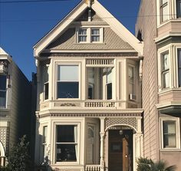
REAL ESTATE
MANAGEMENT
SYSTEM
DBMS PROJECT

Slide 2
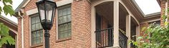
TABLE OF CONTENT
About Us
Vision
Problem Statement
Our Team
Our Services
Solution
Workflow
Website

Slide 3


ABOUT US
Diptendu Majumdar - <diptendu.maj558@gmail.com> (12021002016067, 18)
Adrija Majumder - <adrijamajumder3@gmail.com> (12021002016058, 16)

Slide 4

VISION
Creating an innovative real estate listing platform that seamlessly connects buyers, sellers, and agents, offering rich property information, virtual tours, and personalized recommendations for a streamlined and satisfying property search experience.

Slide 5
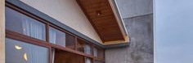
PROBLEM STATEMENT
"Develop a user-friendly mobile app for real estate listings, enabling seamless property search, high-quality images, and detailed information, enhancing the property buying experience."

Slide 6
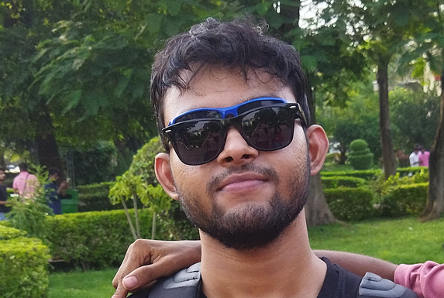
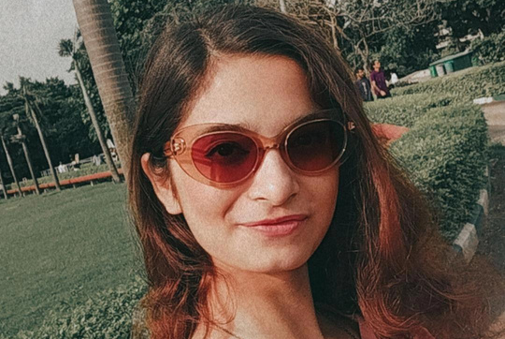
OUR TEAM
DIPTENDU MAJUMDAR
Company Owner
Our team, passionate and driven, aspires to disrupt the real estate market by leveraging technology. We bring fresh ideas, coding skills, and a thirst for innovation to our project.
ADRIJA MAJUMDER
Product Manager

Slide 7
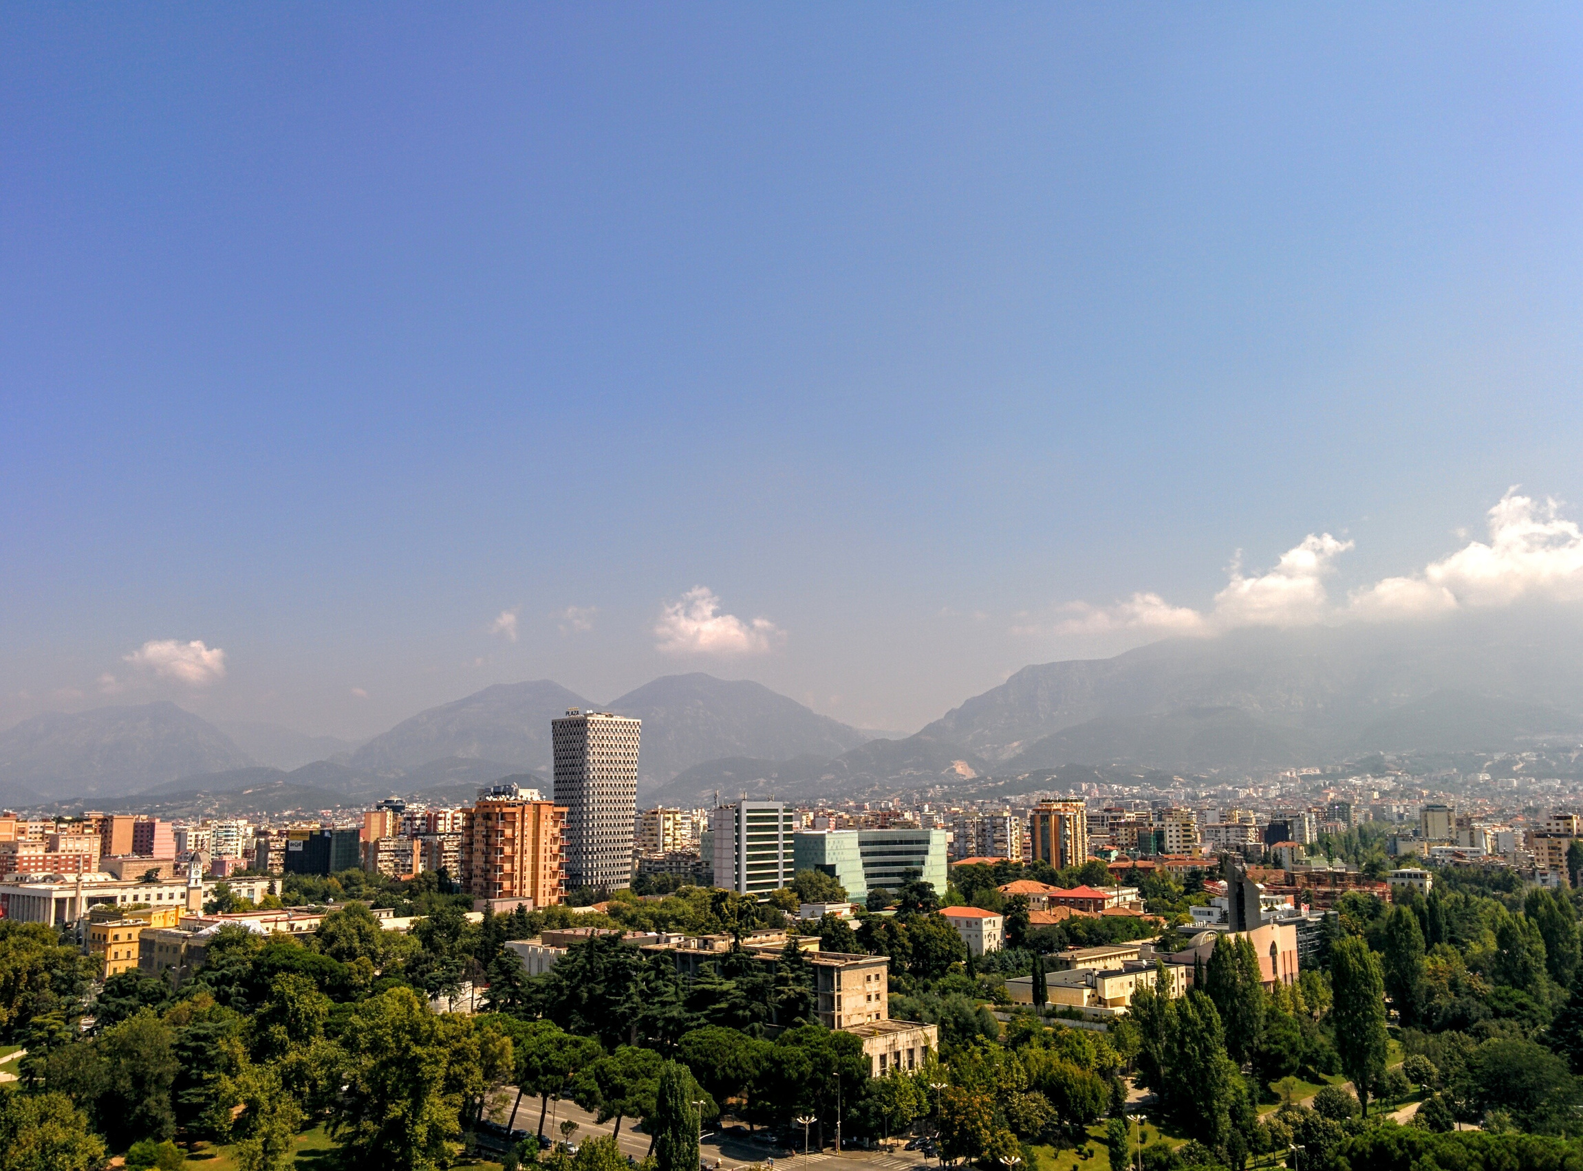



OUR SERVICES
Property Management
Buyer Management
Genuine properties with their details for customers who want to buy/rent properties
Buyers are assured of authentic deals and reliable agents.
Agent Management
Anyone who wants to upload their property to be bought/rented is verified for authenticity.

Slide 8
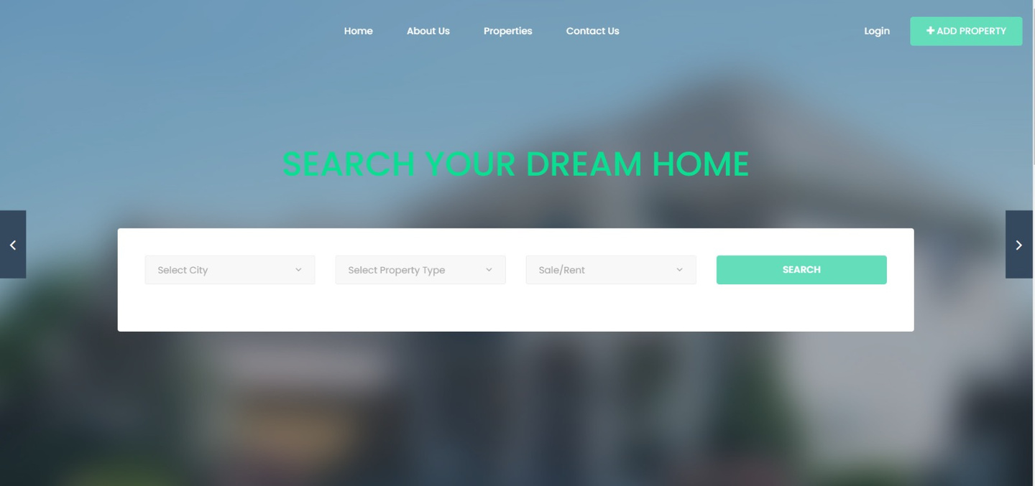
SOLUTION
Creating a user-friendly website or app for real estate listings. Inclusion of search filters, high-quality photos, detailed property info, and contact options. Implement a backend database using PHP to manage listings and user profiles. Advertise the platform to attract both buyers and sellers.

Slide 9




WORKFLOW
Uploading, listing, showcasing, connecting, reviewing.

Slide 10
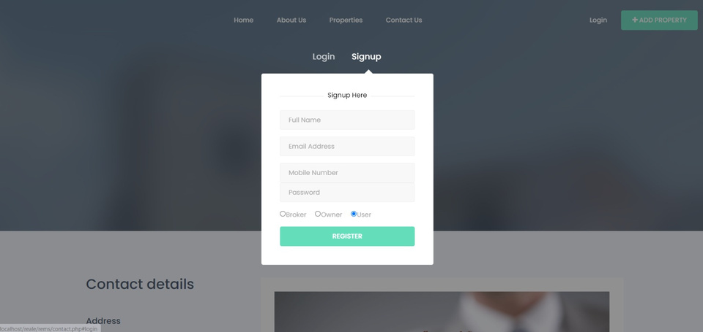


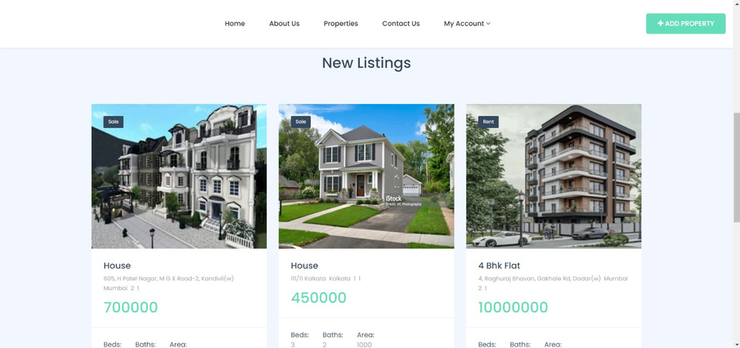
WEBSITE

Slide 11
CONTACT US
We aim to provide a smooth, intuitive and simple solution to our customers who are in the real estate market. However, some issues might have escaped our notice. For any queries, you can contact us on these channels.
PHONE
+91 94330215842
WEBSITE
https://github.com/DMaj-7/RealEstateManagementSystem
EMAIL
diptendumaj588@gmail.com
ADDRESS
18, EP Block, Salt Lake, Bidhannagar, Kolkata - 700091

Slide 12

THANK YOU
https://github.com/DMaj-7/RealEstateManagementSystem

